Slide 1
Progress Report: Nakuja N3
AIRFRAME TEAM • 03.01.2023

Slide 2
Overview
Recent progress
Revision of the parameters#6
Procurement of fibre-glass and Aluminum material
Yet to be finalised
Redesign of the launch rod
Fabrication of the aluminium airframe

Slide 3
Progress - Procurement of materials
Accomplishment 1
We have purchased materials needed for fabrication of the airframe(s)
Obtained documentation for use of workshop facilities
To do
Create a work schedule/timetable
Begin fabrication

Slide 4
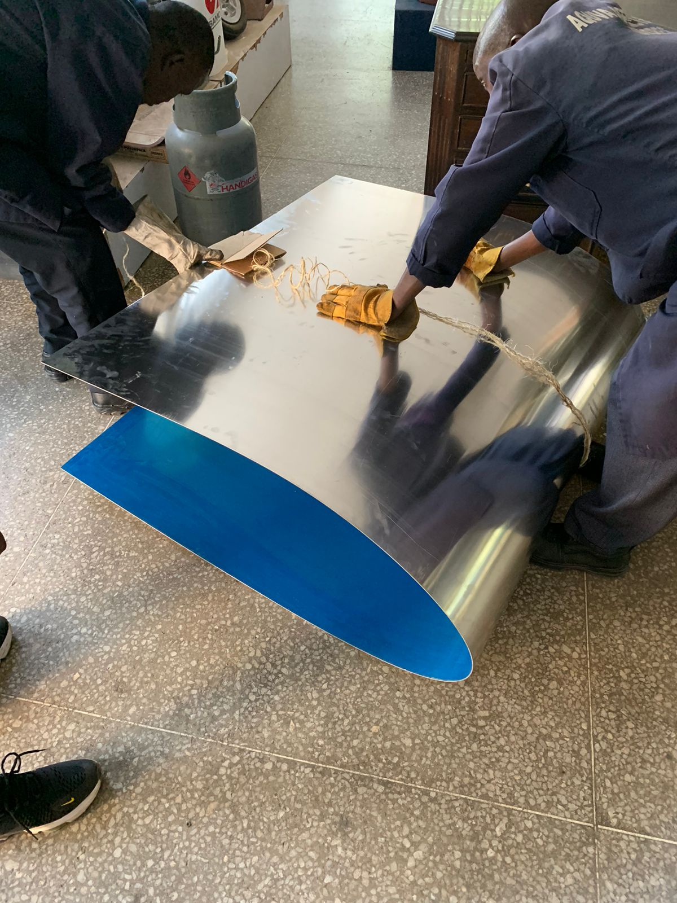
We realized we cannot fold the Aluminium sheet by hand
Resolved to use the sheet roller available in the fitting workshop

Slide 5
Progress - Revision of design
On-going
Found from literature that stability margins of upto 5 calibres are acceptable
Reconfigured the launchrail and fins to match this finding

Slide 6
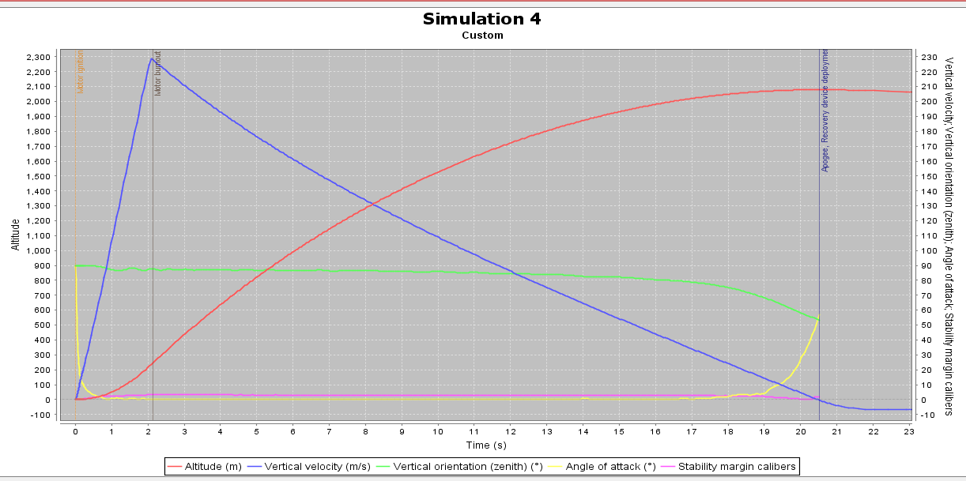
Altitude (2079m)
Angle of attack
Stability (margin calibres)
Vertical orientation (zenith)

Slide 7
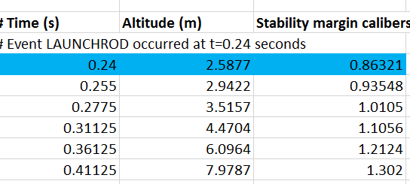
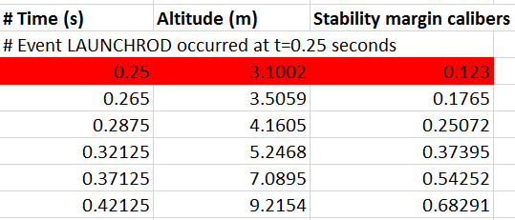
As can be seen the rocket comes off the rod with good stability and with a shorter launch rail
The previous one (highlighted orange) had a launch rail 3m and stability of 0.123 off the rod

Slide 8
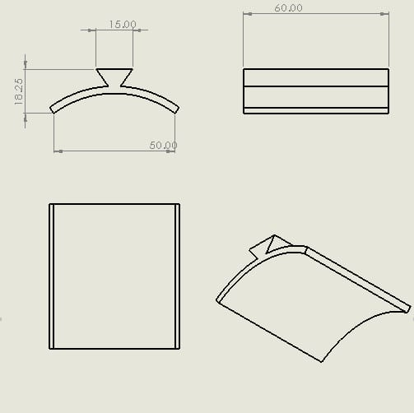
Launch Lug Design
We settled on this design of the launch lug
It interlocks the rocket and rail supporting its weight on the Launchpad

Slide 9
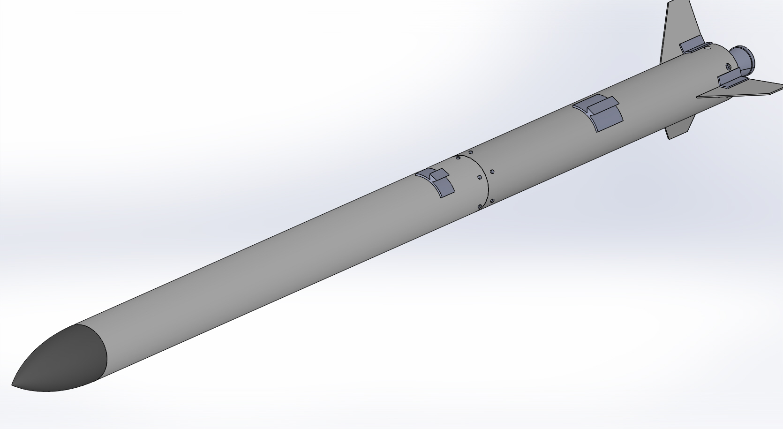

Slide 10
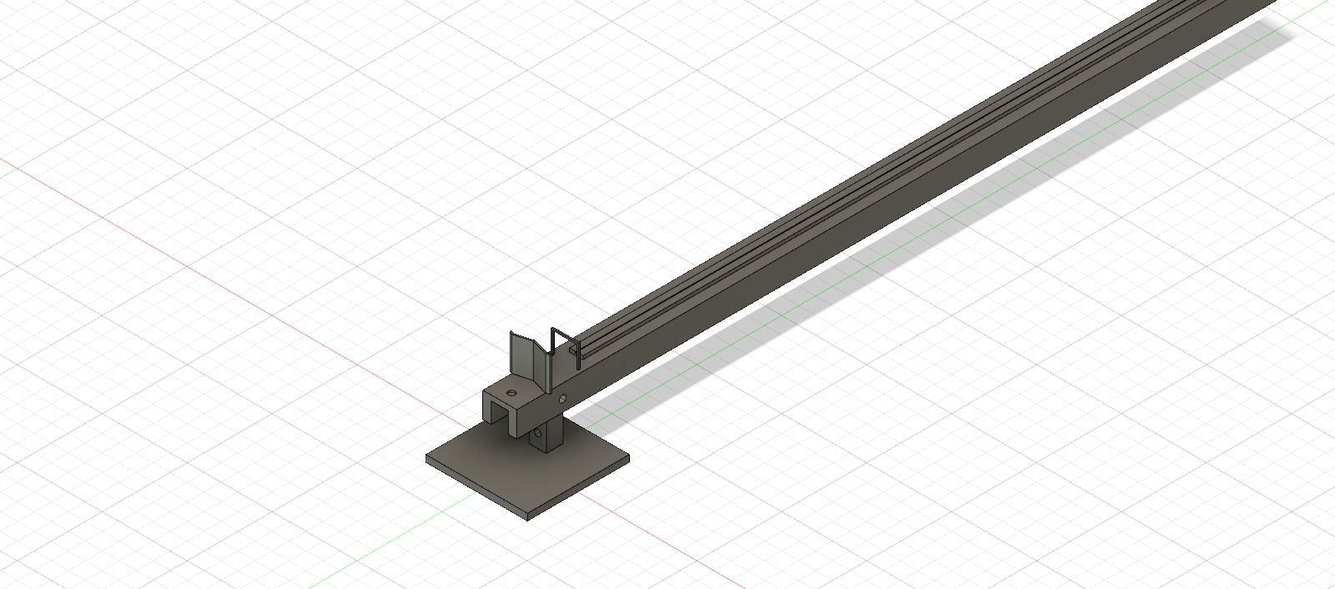
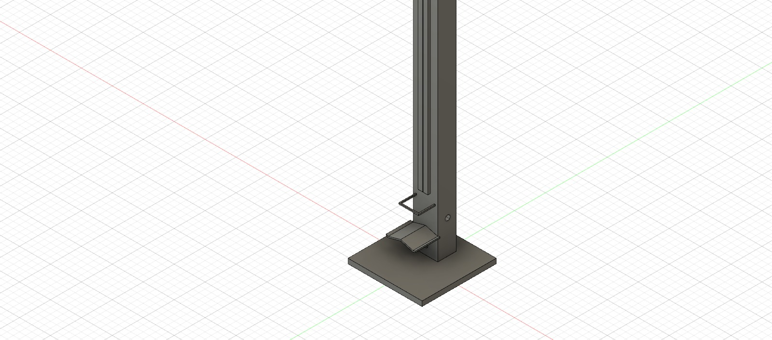
Launch Rail Design
Images of the initial design
stages of the launch pad
The rail is about 2m long
and with the female joint
We are still working on the
support base that meets the
weight requirements

Slide 11
Attention areas
1
Complete the design of the launchpad
2
Begin fabrication of airframes

Slide 12
Goals for next week
Expected delivery
March 4th,2023
Fabrication of the airframe(Aluminum)#20
Finish launch pad design#23

Slide 13
Thank You!

